Slide 1
Scientific Foundations of Health
Module 1:
Good Health and It’s Balance for Positive Mindset
Assistant Professor. Neelima Srivastava

Slide 2
One small positive thought can change your whole day”- Zig Ziglar.
Positive thinking leaves long-lasting effects on our mind and body –
Lesser stress and anxiety
Better immunity leading to resistance to common flu
Better skills to handle panic situations
Better cardiovascular condition
Clearer mind for creativity and problem-solving
Better mood and less depression
Activity: Think of a current situation you can handle with positive thinking

Slide 3






But How Do We Maintain Positive Thinking?
Maintain a Healthy Lifestyle
(Diet + Movement)
Laugh Often
(Smile to Trick Your Mind)
Journal Your Thoughts
(Show Gratitude)
Balance
(Avoid burnout)
Meditate
(Boost Productivity)
Mental Health
(Unlock Possibilities)
Hang Out with Positive People
(Walk the Talk)

Slide 4


Health and Wellness
Optimal state of health of individuals and groups expressed with positive approach to living
State of complete physical, mental and social well-being and not merely the absence of disease or infirmity
Life
Active process of growth and change to reach your fullest health and well-being.
Proactive activities, lifestyle changes, controlling risk factors, focusing on nutrition, having a balanced diet, and following spiritual practices that lead to holistic health
Cannot choose state of health
Comprises the diagnosis of a disease/illness, predisposition to a disease, and any unexpected injury
Enables happy and disease-free life
Health
Wellness

Slide 5
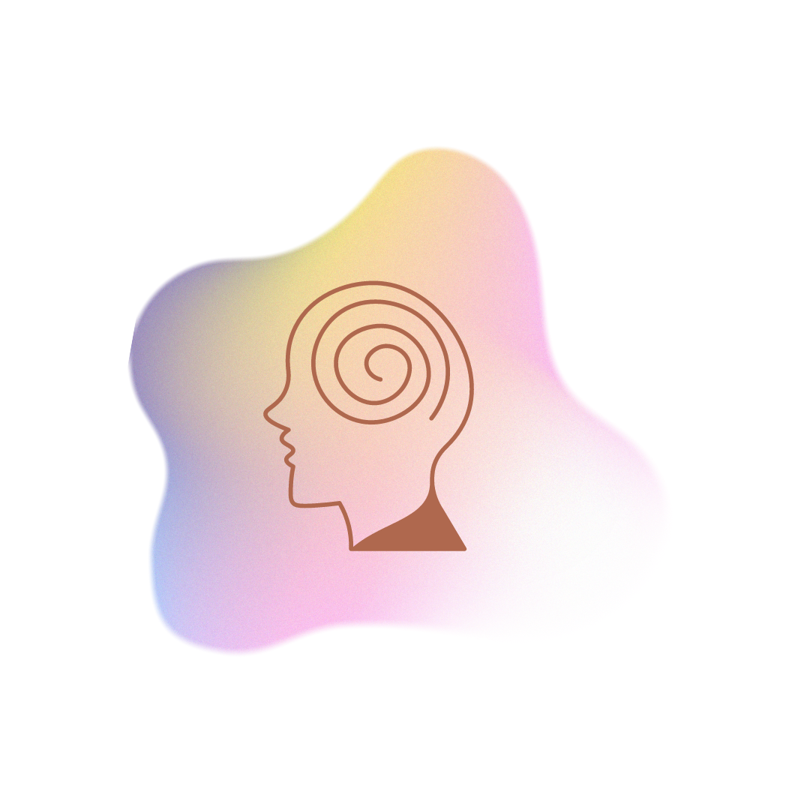

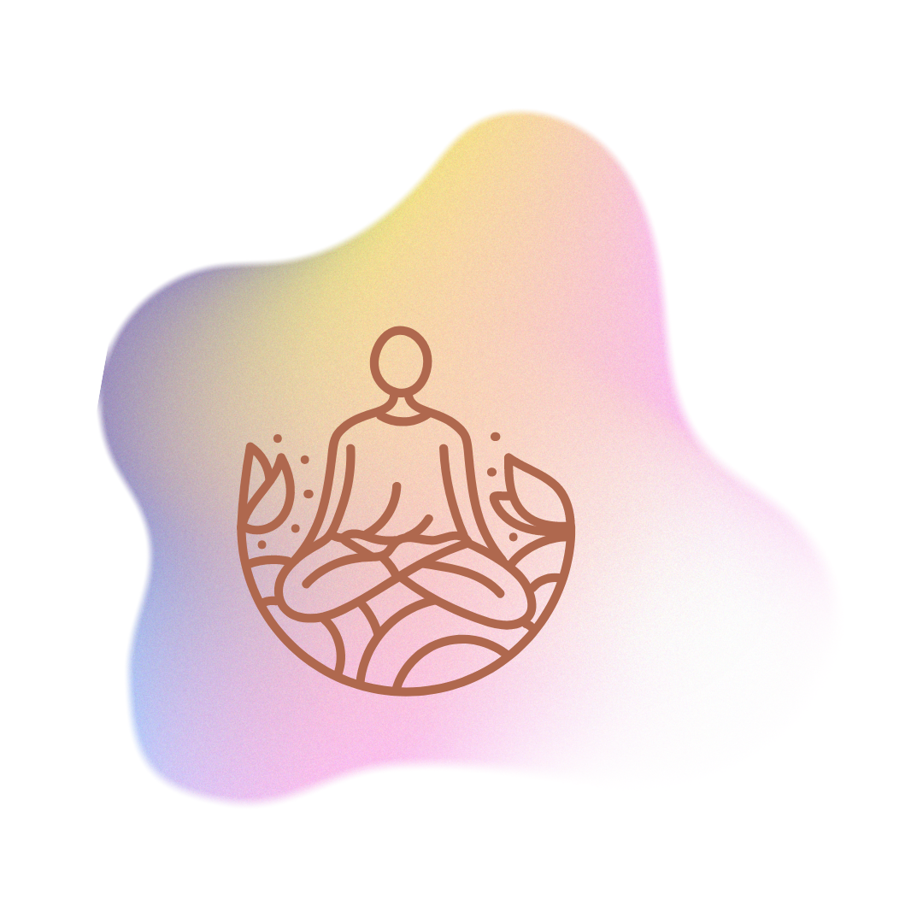


Dimensions of Wellness
Physical
Emotional
Mental
Social
Environmental
Increase physical fitness
Avoid sedentary lifestyle
Eat a balanced diet
Stay hydrated
Self awareness of emotions
Empathy for self and others
Deal well with stress
Mental exercises - creativity and problem-solving skills
Challenge your mind
Contributing to community
Interpersonal long-term relationships
Support network
Protecting nature
Living sustainably
Promoting environment friendly activities

Slide 6


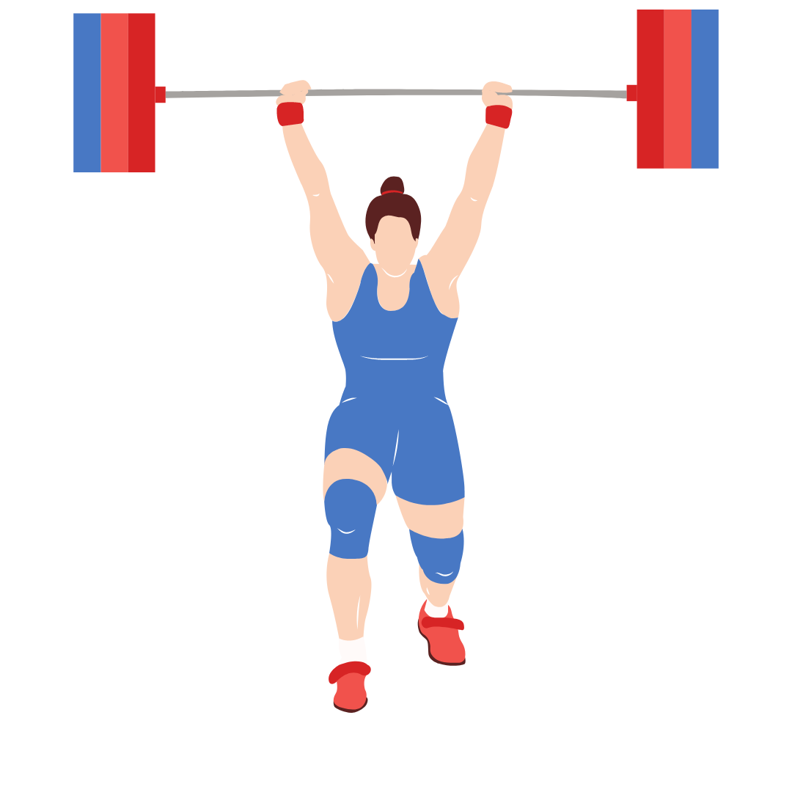


Identified Risks Leading to Poor Health
Lifestyle habits such as alcohol & drug abusing, smoking & vaping, binge eating, extreme physical exercise and unprotected sex pose as risks to long-term health. These actions are usually developed in the growing years (ages 13- 27).

Slide 7
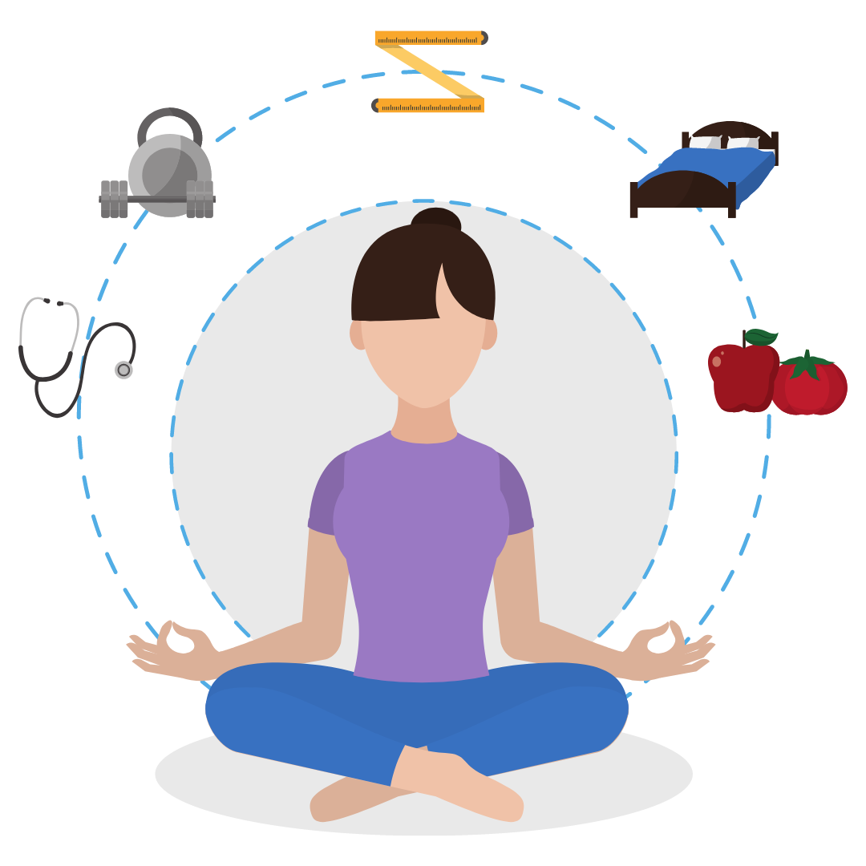
Health is the body’s functional and metabolic efficiency, and its ability to adapt to the physical, mental, and social changes that it is exposed to.
It is important to approach “health” as a whole, rather than as a series of separate factors. Good physical health can work in tandem with mental health to improve a person’s overall quality of life.

Slide 8
Let’s Evaluate Physical and Mental Health
Physical Health | Mental Health
Physically healthy people are likely to have bodily functions and processes working at their peak due to the absence of diseases. | Mentally healthy people can enjoy life, bounce back after difficulties, balance personal and professional relationships with ease.
Regular exercise, balanced nutrition, and adequate rest contribute to good health. Maintaining physical fitness, breathing and heart function, muscular strength, flexibility, and body composition. | A chronic illness affects a person’s ability to complete their regular tasks, it may lead to depression and stress. These feelings could be due to financial problems or mobility issues. A mental illness, such as depression or anorexia, can affect body weight and overall function.

Slide 9






Good Health = Good Life
I feel comfortable and happy with my life <3
I don't have a desire for addictive substances!!!
I have a vision and the belief to achieve it !
I can serve myself, my family and community
I save money on insurance and medical costs :)

Slide 10

Activity: How Healthy Are YOU? Give yourself 1 point per checkmark
Eat 3 balanced meals a day
Slept enough last night
Drink 3 litres of water a day
Did not booze or get high
Exercise regularly
Have enough money to sustain
Maintain good hygiene
Not be moody or anxious today

Slide 11
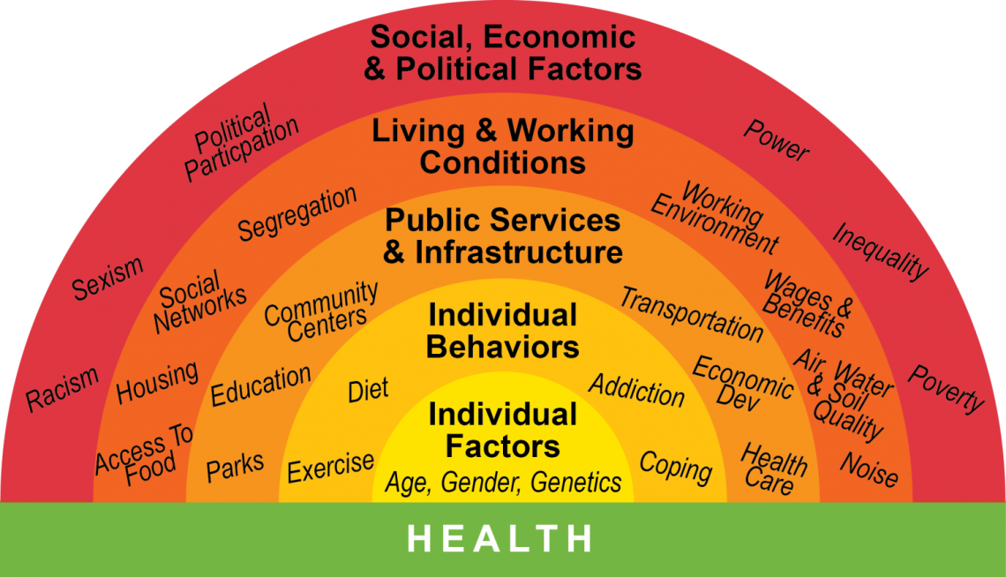
Various Factors Affect Our Health and the Ability to be Healthy

Slide 12
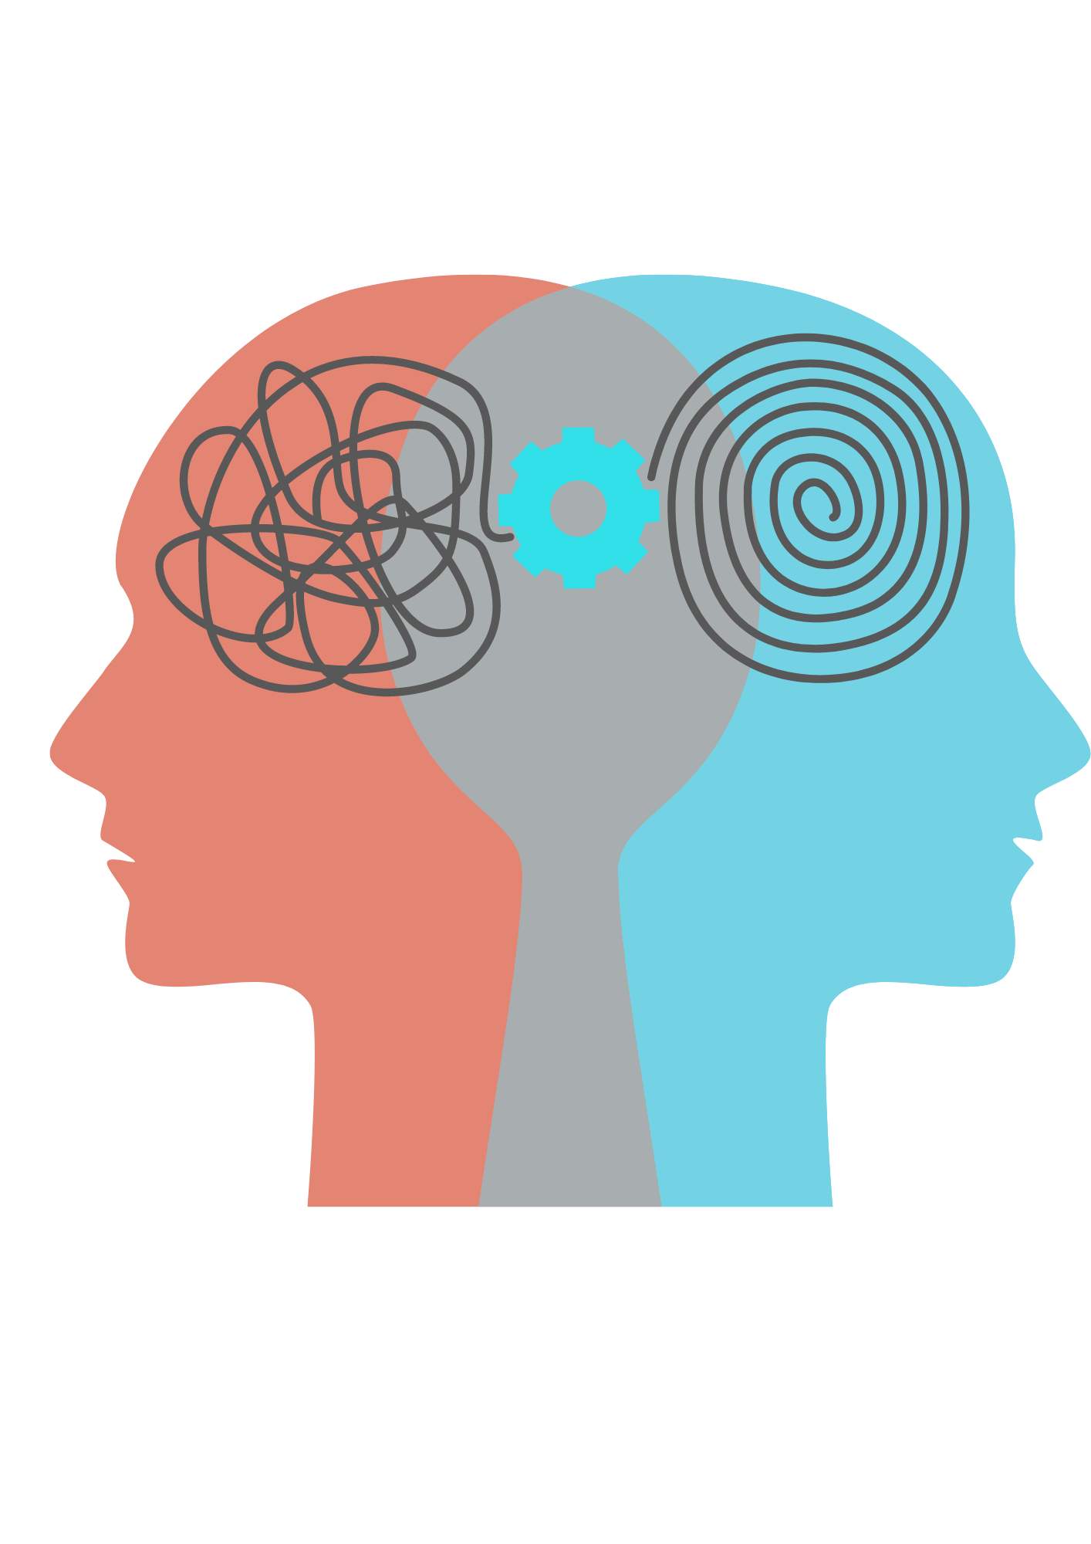
Our Behavior Makes Us Approach Health Positively or Even Negatively
Addressing health behaviors requires strategies to encourage individuals to engage in healthy behaviors and access nutritious food, safe spaces to be physically active, and support to make healthy choices.
Health Belief Systems Enforce Decisions
What people believe about their health?
What they think constitutes their health?
What they consider the cause of their illness and ways to overcome it?

Slide 13
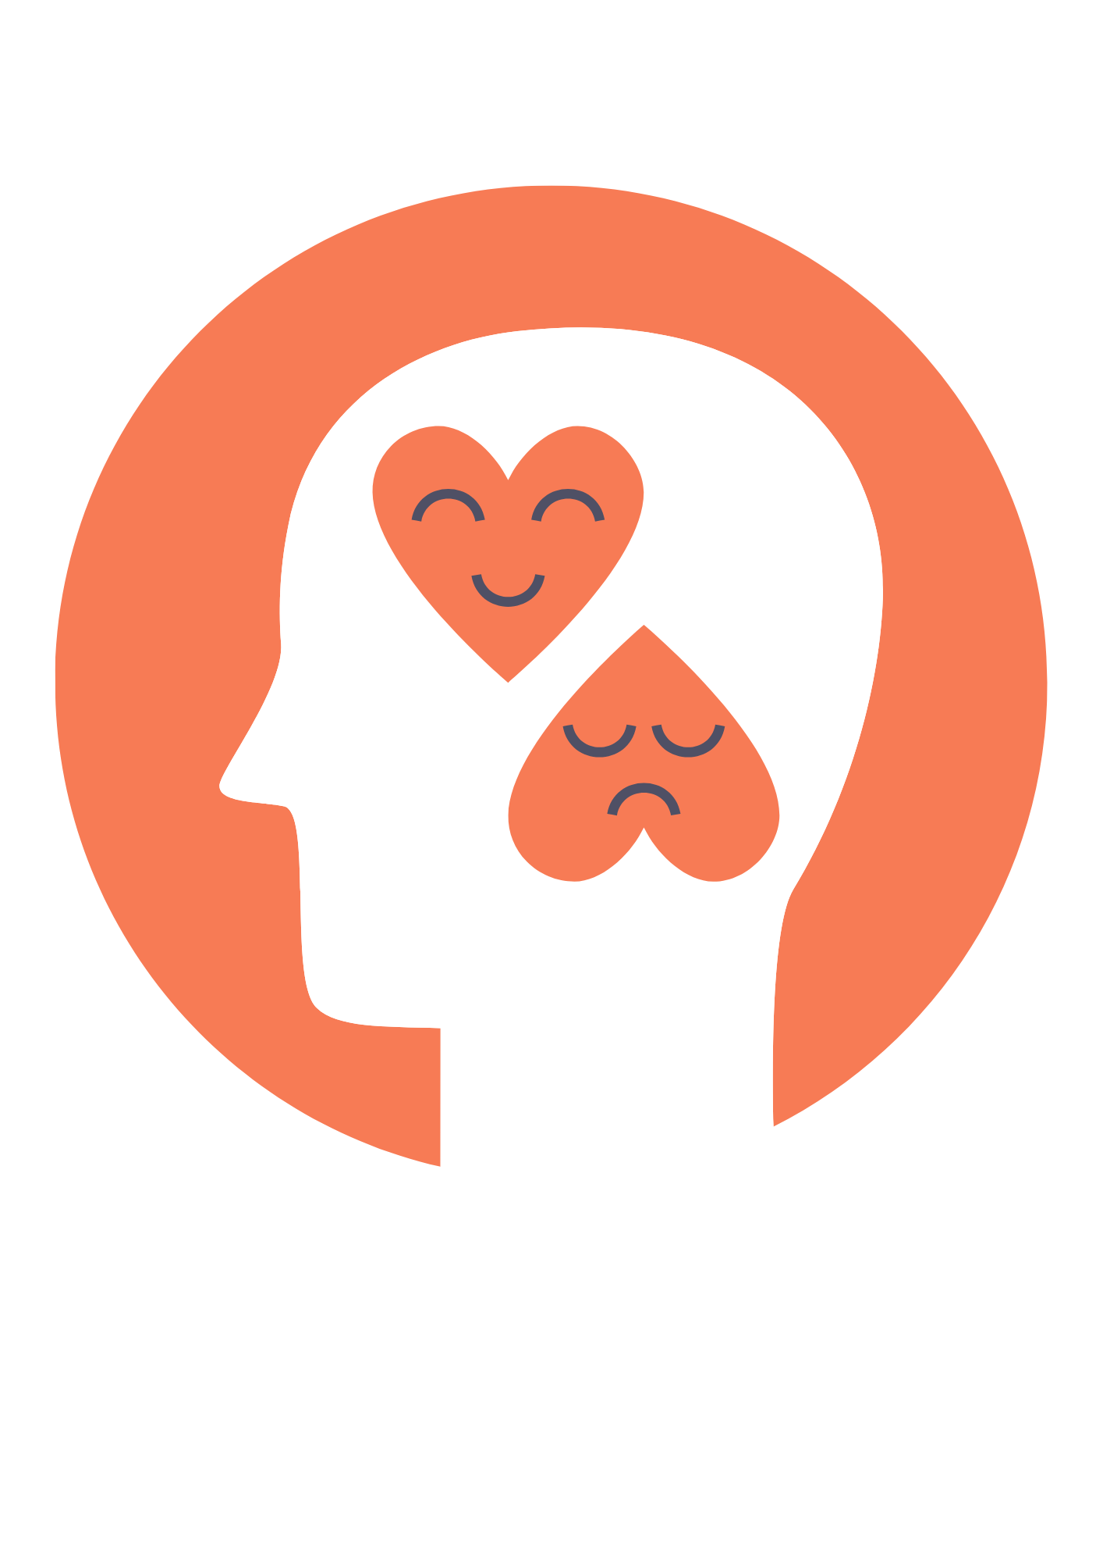

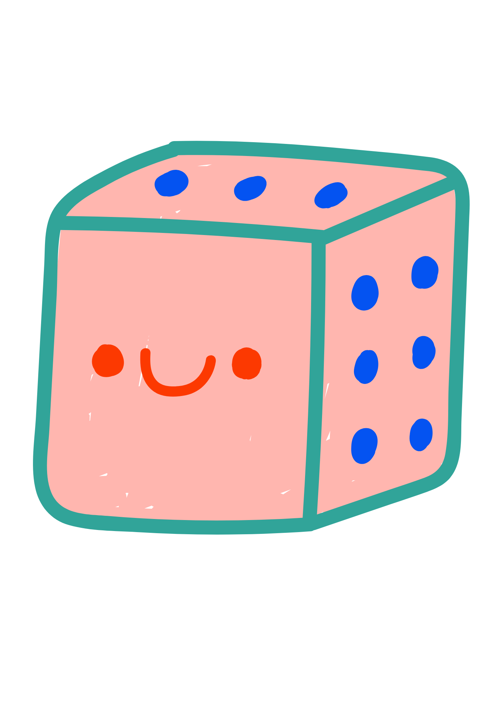
Human Behavior Model (HBM) Attempts to Predict Health-Related Behavior in Terms of Certain Belief Patterns.
Individual Perceptions
=
Perceived Susceptibility
+
Perceived Severity
Modifying Factors
=
Gender + Age + Ethnicity + Personality + Socioeconomics + Knowledge
Likelihood of Action
=
Perceived Benefits + Perceived Threats + Perceived Barriers

Slide 14


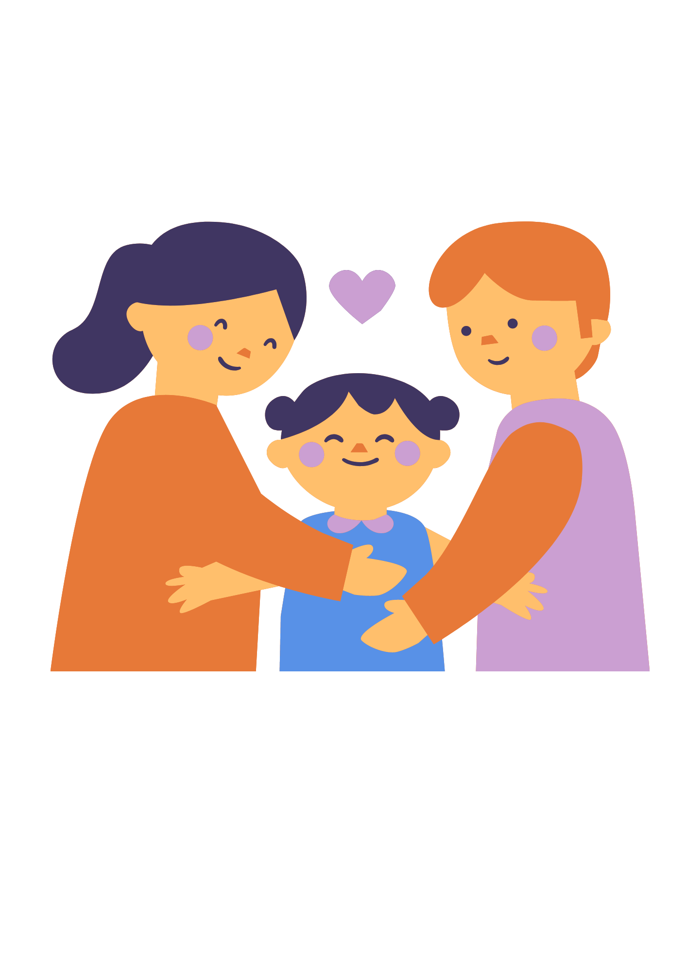
Situations Change Health Behaviors
Advertising
Family
Society
Objectification of youth, eating disorders, low self-esteem and body dissatisfaction.
Convince users that products are better than they are.
Family members regulate supportive behaviors.
Family influence health attitudes.
Negative comments by family increase likelihood of mental illness.
Social relationships are vital for good health.
Social isolation creates added health risks.
Good health enables people to play a part in society.

Slide 15
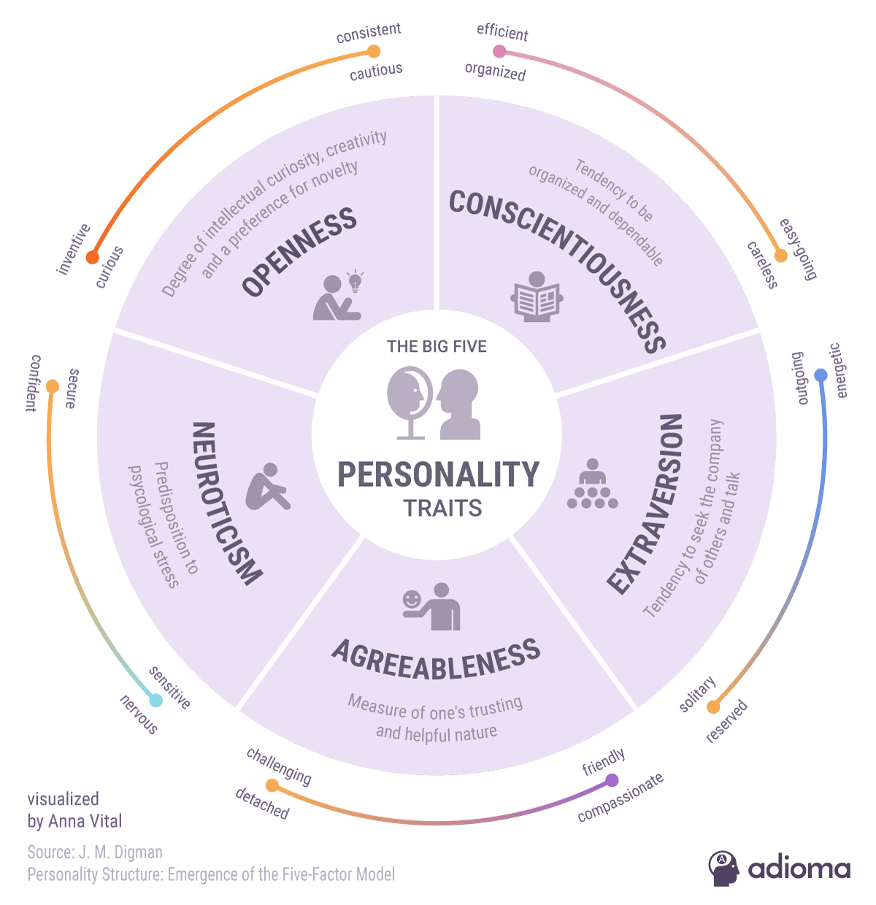

Slide 16
Stress and Types of Stress
Stress is your body’s response to anything that requires attention or action. Stress can be defined as any type of change that causes physical, emotional, or psychological strain.
Acute
Stress
Short-term type of stress that can either be positive or more distressing during day-to-day life.
Chronic
Stress
Never-ending and inescapable stress during big events like a bad marriage or tough job.
Episodic Acute Stress
Run rampant and be a way of life, creating a life of ongoing distress.
Eustress
Associated with surges of adrenaline making one feel energized.

Slide 17
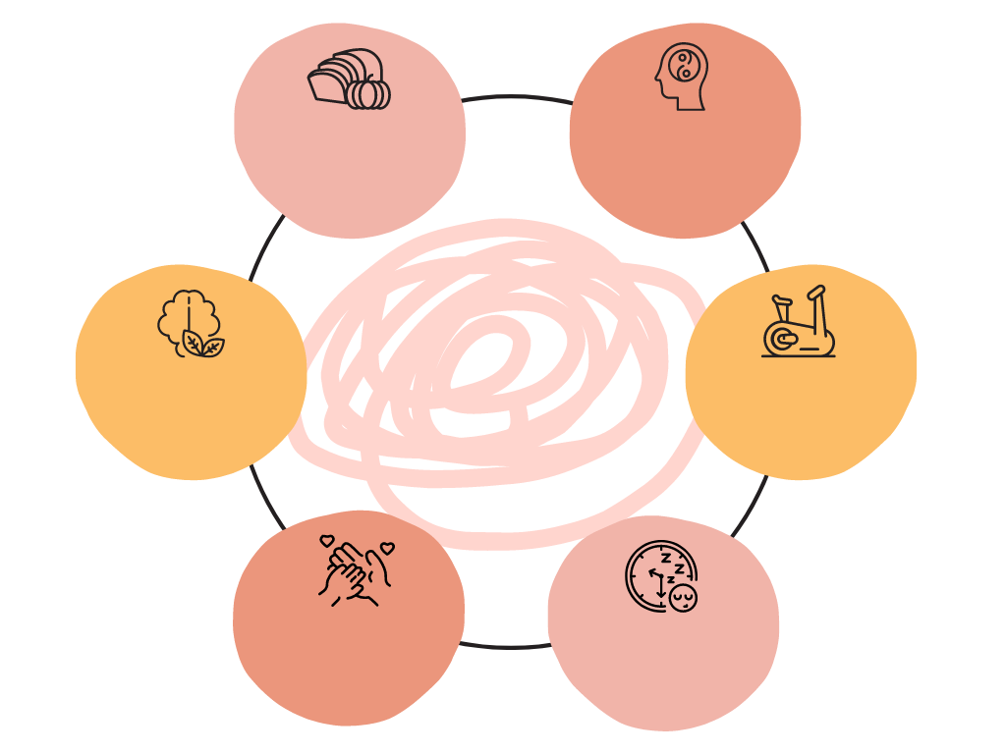
Eat Fruits and Veggies
Mindfulness
Coping with Stress
Exercise Regularly
Be Attentive to Thoughts
Gratitude
Deep Sleep

Slide 18
Questions & Answers
Over to you!

Slide 19
Resources
List the resources you used for your research:
Health Psychology- Biopsychosocial Factors in Health and Illness. Authors: Larry C. Barnard & Edward Krupat. Harcourt Brace College PublishersSource #2
Health Psychology. Ninth edition. Shelley E. Taylor . McGraw Hill Edition. India Pvt. Ltd.
Health Psychology. By M. Robin Dimalleo. Leslie R. Martin. Pearson Education Parling Kindersley (India)

